Slide 1
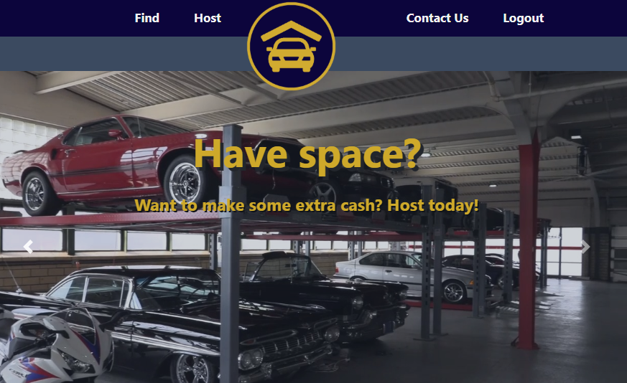
Garaged App
Authors:
Nick Cox
Eric Simmons
Zac Talley
Mario Cortes

Slide 2
In a Nutshell
Garaged provides a platform for people who need to rent temporary storage space connect with people who are willing to lease their own storage space while profiting from doing it.
But why would anyone want to use my garage instead of just renting a storage unit? Two words can answer this question:
Cost & Convenience
Not to mention, we live in a generation where people are tired of making the rich richer and WANT to spread the dollar around within their own community

Slide 3
Concept / User Story
Imagine…
You just downsized from a house with lots of space into a small apartment with barely enough space for you, let alone all of your belongings. Maybe you and a significant other decided to move in together and now you have too much stuff and not enough space; Or maybe you’ve got a jet ski, 4 wheeler, motorcycle or car that you know you’re not going to be able to use for a while and you need a place to store it and keep it safe from the elements.
On the other hand…
Maybe you’ve got plenty of extra , unused storage at your place and you could use a little extra residual income.
Just like Craigslist, AirBnB, Uber and other similar apps provide a platform that connect people with a specific need with other people who are able to provide a solution, Garaged now provides a way to connect people who need to rent storage space with people that can solve their needs while generating income for themselves.

Slide 4
Technologies Used
In creating this app, these are some of the technologies/skills that were used:
Node
Express
Express Handlebars
Sequelize
Passport
Bcrypt
CSS
Bootstrap
GitHub
Version Control
Libraries
jQuery
Testing
Postman
Chai
Jest
API
Cloudinary
Deployment
Heroku

Slide 5

Challenges
Challenges
Creating test environment to seed database in local machines
Multiple database write-back issues
Project Management and Planning
Project Timing and Holiday Break

Slide 6
Roles
Nick Cox
DB / Functionality & Integration
Eric Simmons
UI Developer
Zac Talley
Passport and Presentation developer
Mario Cortes
Database Developer, Testing, Presentation & Documentation

Slide 7
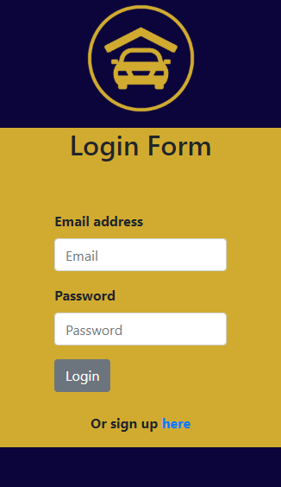
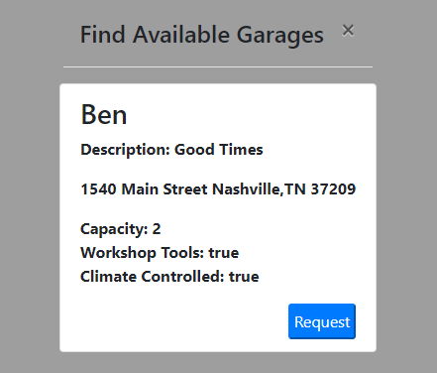
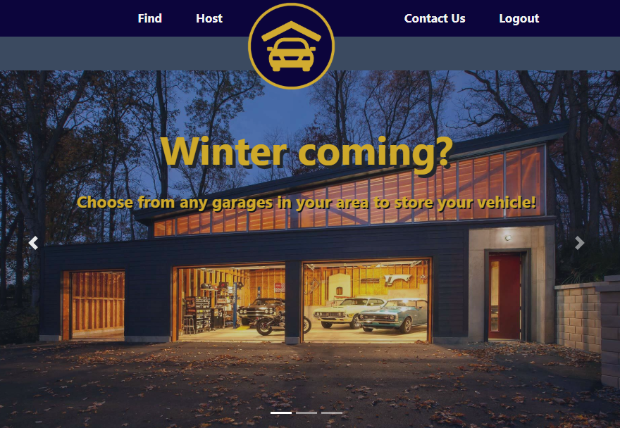
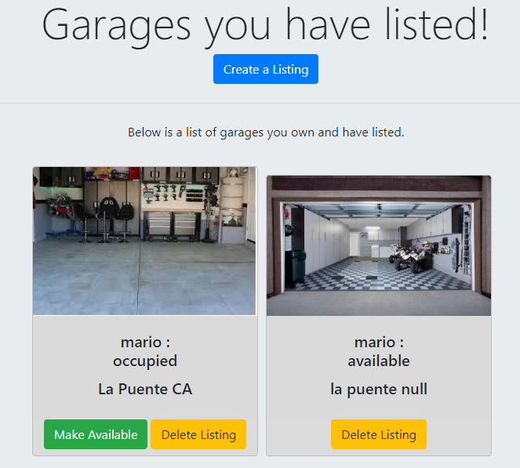
Live Demo / Links
Link to repository:
https://github.com/EricEnergy/garaged
Link to live site:
https://whispering-dusk-10991.herokuapp.com/

Slide 8

Future Development
Functionality to add user profile photos
Feature to submit contact requests
Payment platform
User Ratings
Ability to edit unit info
Functionality to search by zip code and radius

